Slide 1




NAME : G.BENITA SHARON
NM ID : AU211521104020
COLLEGE NAME : PANIMALAR INSTITUTE OF TECHNOLOGY

Slide 2
“EVENT
CORRELATION
ANALYSIS“

Slide 3
PROJECT INTRODUCTION
Event correlation is pivotal for deciphering complex data relationships. By marrying this concept with Artificial Neural Networks (ANN), we unlock potent analytical capabilities. Today, we explore ECANN - the synergy of event correlation analysis and ANN - and its transformative potential.Event correlation uncovers patterns within datasets, guiding decision-making across industries.ANN, mimicking the brain's neural structure, excels in pattern recognition and data analysis tasks.ECANN leverages ANN's prowess to discern subtle data correlations, aiding real-time decision-making and prediction.Data Preparation: Cleanse and format event data.Model Design: Craft ANN architectures suitable for correlation tasks.Training and Optimization: Fine-tune models for optimal performance.Real-Time Analysis: Deploy models to extract insights from streaming dataFrom finance to cybersecurity, ECANN finds applications in various domains, revolutionizing insights and decision-making processes.

Slide 4
Overview of event correlation and its significance in data analysis.
Importance of identifying relationships and patterns among events for decision-making.
Gathering diverse event data sources for analysis.
Preprocessing steps to clean, standardize, and format event data for input into the ANN model.
Selection of suitable ANN architecture for event correlation tasks.
Determining input features and target variables for the ANN model.
Training process using preprocessed event data.
Learning patterns and relationships within event data to enable effective correlation analysis.
Extracting key features from event data, such as event types, timestamps, and contextual information.
Classification of events based on their relevance and significance.
Continuous monitoring and analysis of incoming event streams to identify correlations and patterns.Assessment of ANN model performance using relevant evaluation metrics.
Ensuring accuracy, precision, and reliability in event correlation results.
Addressing challenges in event data quality, volume, and complexity.Exploring potential advancements in ANN-based event correlation techniques.Emphasizing the role of ANN in automating and enhancing event correlation capabilities.
AGENDA OF THIS PROJECT

Slide 5
PROBLEM STATEMENT
The project aims to tackle the challenge of event correlation using Artificial Neural Networks (ANN) within the context of data analysis. Traditional methods often struggle to effectively identify relationships and patterns within complex event datasets, leading to inefficiencies and inaccuracies. By harnessing the capabilities of ANN, we seek to develop a robust and automated system capable of accurately correlating events in real-time. The primary goal is to design an ANN model that can efficiently process diverse event data sources, learn patterns and dependencies, and provide timely insights for informed decision-making. Through this project, we aim to address the limitations of conventional event correlation methods and provide organizations with a powerful tool for extracting actionable insights from their data.

Slide 6
PROJECT OVERVIEW
The project focuses on leveraging Artificial Neural Networks (ANN) to automate event correlation, a vital task in data analysis. By employing ANN, we aim to develop an efficient system capable of identifying relationships and patterns within complex event data. This innovative approach involves gathering diverse event sources, standardizing their format, and preprocessing the data for input into the ANN model. The trained ANN model learns patterns and correlations from the data, enabling real-time analysis of incoming event streams. Our goal is to deliver a scalable and accurate event correlation system that provides timely insights for informed decision-making.

Slide 7
END USERS OF THE PROJECT
The end users of the project "Event Correlation using ANN" encompass a wide range of industries and organizations seeking to enhance their data analysis capabilities. This includes financial institutions aiming to detect market trends and anomalies, cybersecurity firms needing to identify and respond to security threats, telecommunications companies striving to optimize network performance and detect faults, and healthcare organizations looking to improve patient care through predictive analytics. Additionally, government agencies, manufacturing companies, and retail businesses can benefit from the insights provided by the automated event correlation system. By catering to the diverse needs of these end users, the project aims to empower decision-makers with timely and accurate insights derived from complex event data.sl. Nam elementum nunc quis sapien pretium, at tincidunt mauris dignissim.

Slide 8
The proposed solution for event correlation using Artificial Neural Networks (ANN) offers a transformative approach to data analysis, providing organizations with a powerful tool to extract actionable insights from complex event datasets. By leveraging the capabilities of ANN, our solution automates the process of identifying relationships and patterns within event data, enabling real-time correlation and analysis. The value proposition lies in the accuracy, efficiency, and scalability of the system, allowing users to make informed decisions based on timely insights. By streamlining event correlation tasks, our solution enhances operational efficiency, reduces manual effort, and improves the overall effectiveness of decision-making processes. Ultimately, the system empowers organizations across various industries to gain deeper insights into their data, leading to improved performance, risk management, and competitive advantage in today's data-driven landscape.
SOLUTION AND ITS VALUE PROPOSITION

Slide 9
WOW FACTOR OF THE PROJECT
The "wow" factor of the project "Event Correlation using ANN" lies in its ability to revolutionize data analysis and decision-making processes across industries. By harnessing the power of Artificial Neural Networks (ANN), our solution offers a groundbreaking approach to event correlation, enabling organizations to unlock hidden insights within complex datasets. The automated system, powered by ANN, seamlessly processes diverse event data sources in real-time, uncovering intricate relationships and patterns that may have otherwise gone unnoticed. This capability to efficiently correlate events and extract actionable insights provides a significant competitive advantage, empowering users to make informed decisions swiftly and effectively. With its accuracy, efficiency, and scalability, the project introduces a paradigm shift in how organizations leverage data for strategic decision-making, setting new standards for excellence in data analytics and propelling them towards success in today's dynamic business environment

Slide 10
The modeling aspect of the project "Event Correlation using ANN" involves designing and training an Artificial Neural Network (ANN) architecture tailored specifically for event correlation tasks. This process encompasses several key steps, including data preprocessing, feature selection, model architecture design, training, and evaluation. Initially, diverse event data sources are collected and preprocessed to standardize their format and ensure compatibility with the ANN model. Subsequently, relevant features such as event types, timestamps, and contextual information are selected for input into the ANN. The model architecture is then meticulously designed, considering factors such as network depth, width, activation functions, and optimization algorithms. During the training phase, the ANN learns to identify patterns and correlations within the event data, iteratively adjusting its parameters to minimize prediction errors. Finally, the trained model is evaluated using appropriate metrics to assess its performance and accuracy in correlating events. Through this comprehensive modeling approach, the project aims to develop a robust and efficient event correlation system powered by ANN, capable of providing valuable insights for informed decision-making.
MODELLING

Slide 11
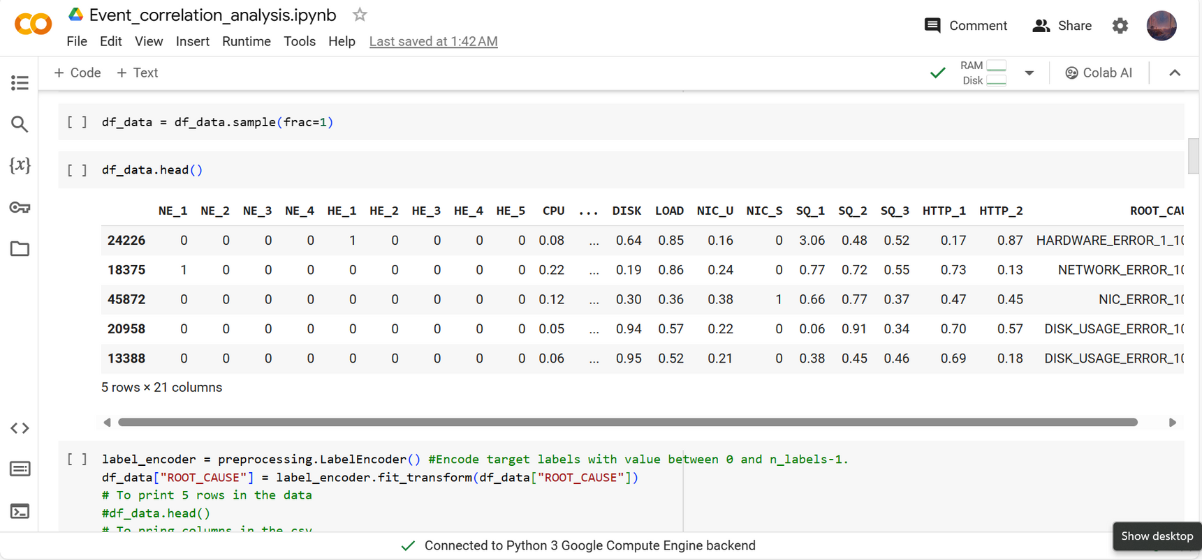
RESULTS

Slide 12
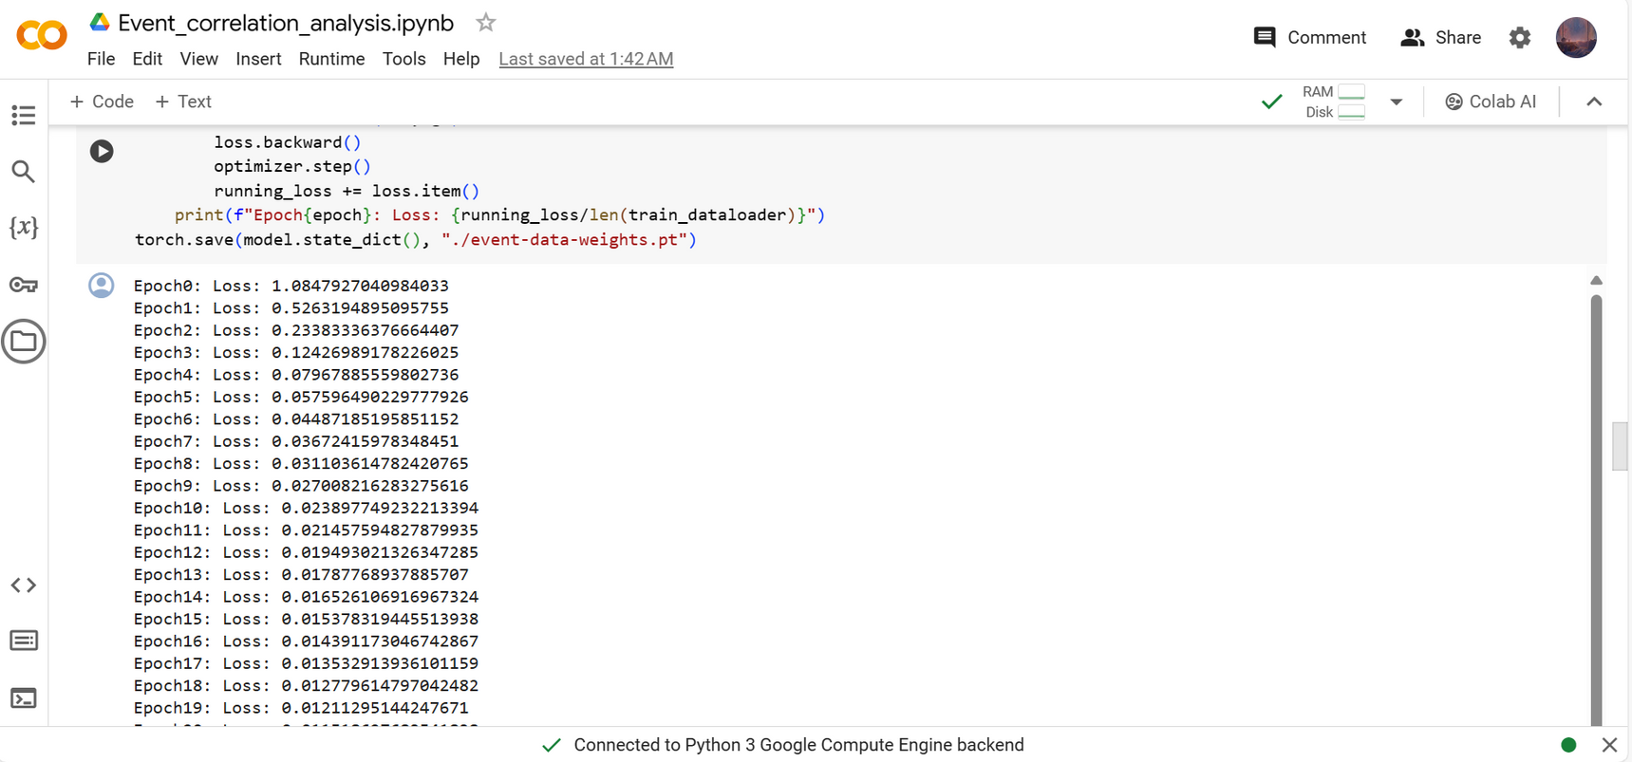
RESULTS

Slide 13
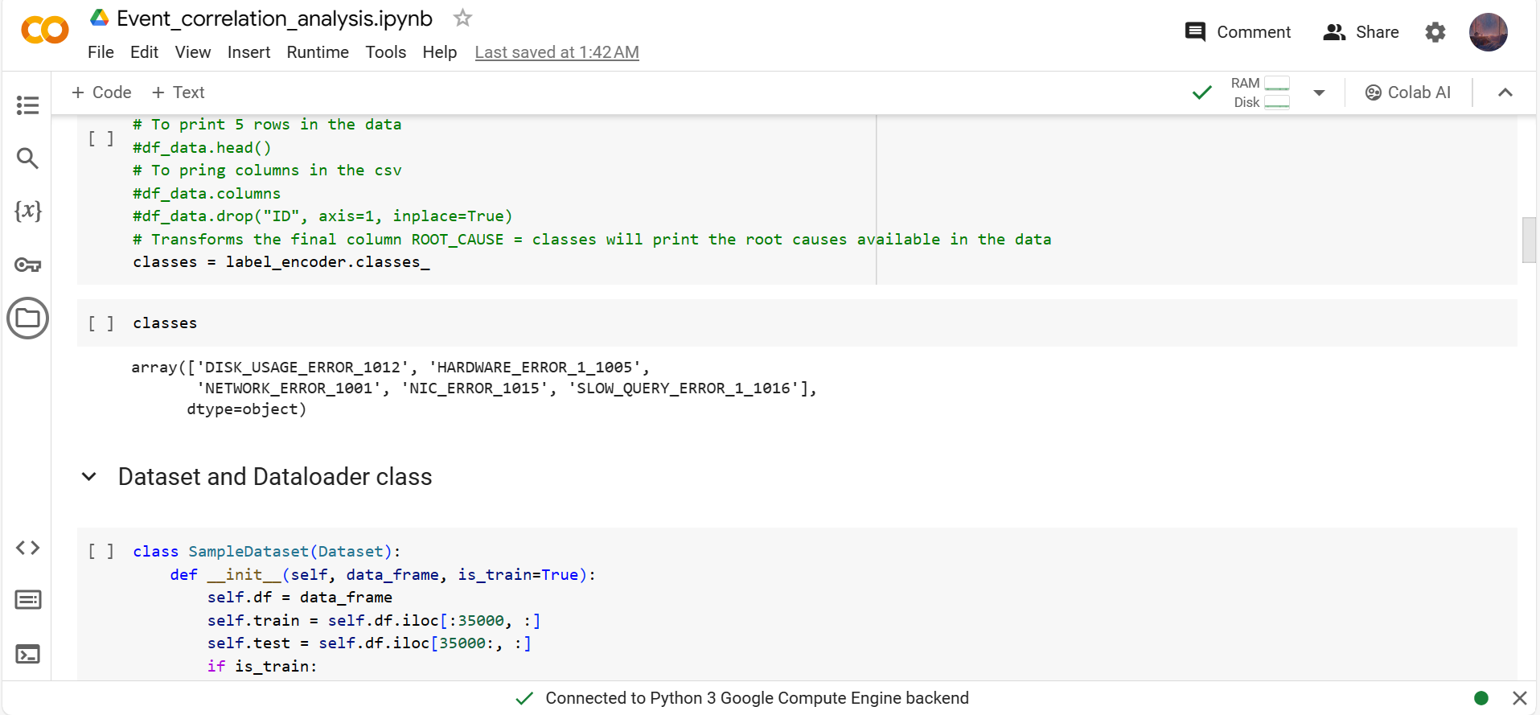
RESULTS

Slide 14
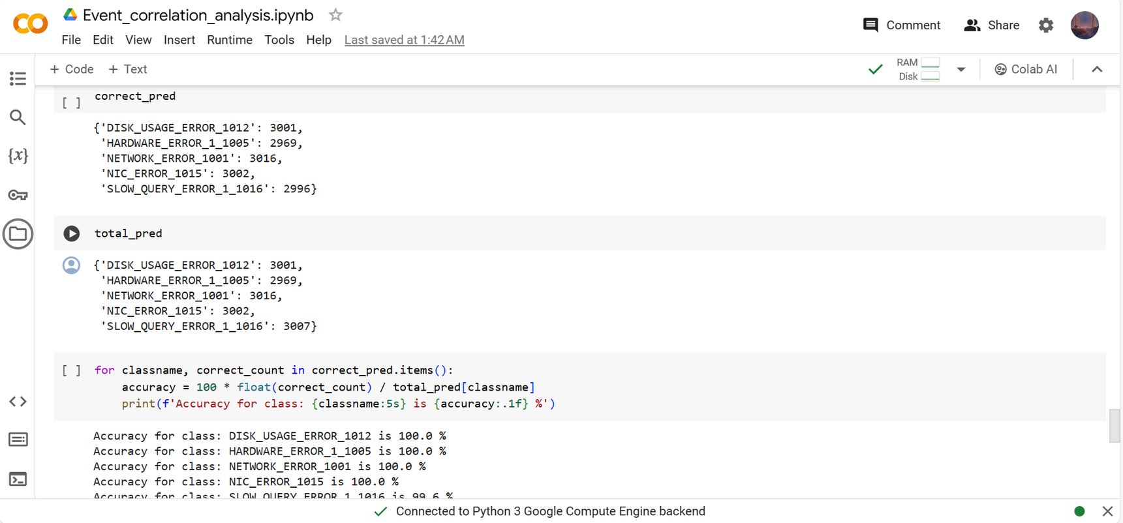
RESULTS

Slide 15
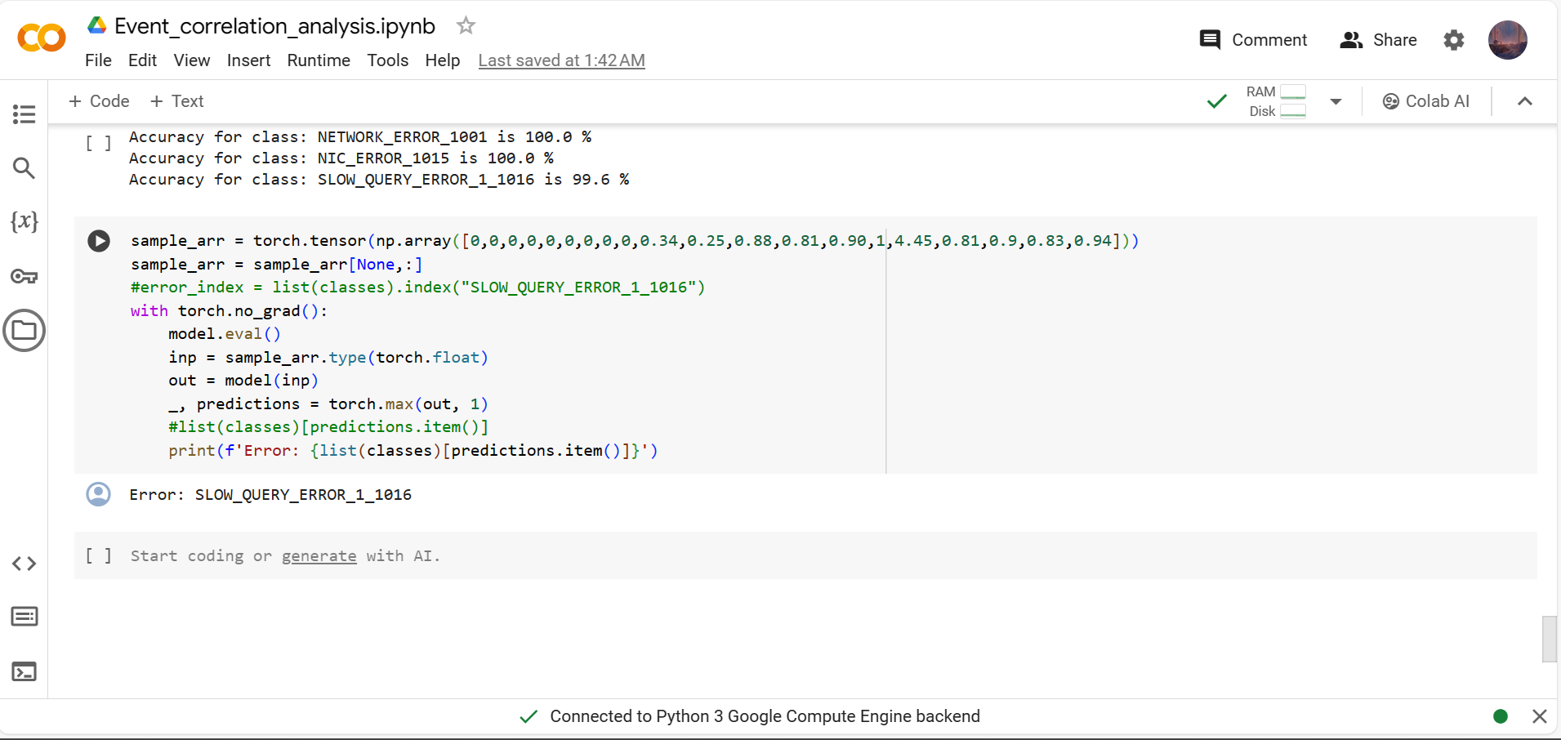
RESULTS

Slide 16
DEMO LINK
EVENT CORRELATION ANALYSIS

Slide 17
THANK YOU

